Slide 1
Enabling Citizen Data Scientists with RStudio Academy
Dow Core Research & Development
James Wade
RStudio Meetup | June 21st, 2022

Slide 2
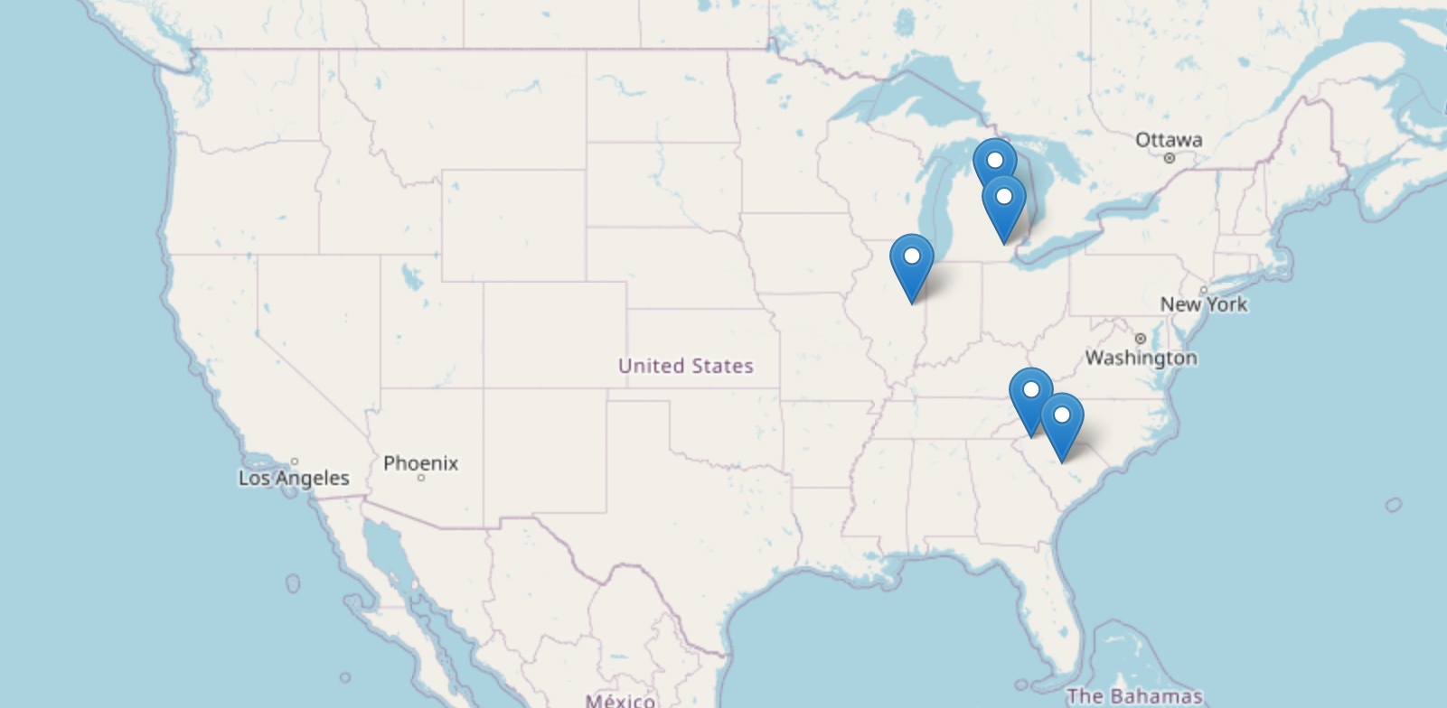
About Me
Education and Work Experience
👨‍🔬 2018, Chemist at Dow, Midland, MI
👨‍🔬 2017, Postdoc, University of Michigan
🎓 2017, PhD in Chemistry, University of Illinois
🎓 2012, BS in Chemistry, Furman University
Interests and Research Focus
⚖️ Structural Characterization of Materials
🌱 Discovery & Analysis of Sustainable Materials
🤖 High Throughput Research & Automation
📈 Data Science, Statistics, & AI / ML

Slide 3

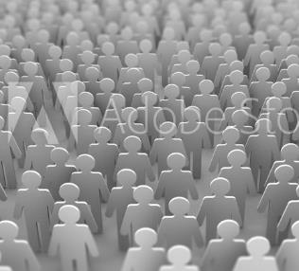
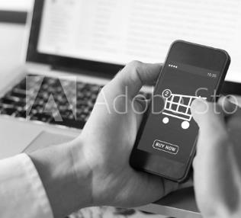





About Dow
GLOBAL MEGATRENDS
CLIMATE CHANGE AND RESOURCE SCARCITY
MIDDLE CLASS GROWTH
DIGITAL TRANSFORMATION
URBANIZATION
50%
GHG emissions, driven by energy demand in emerging economies
Global middle class is expected to reach
Worldwide spending on digital transformation will reach
By 2045, the world’s urban population will increase by
5.5B
$6.8 TRILLION
1.5X
60%
food needed to feed 9.7B people by 2050
by 2030
to 6 billion people. Cities face systemic urban challenges in a post-COVID society.
between 2020 and 2023
CHANNELING DOW’S MATERIALS SCIENCE EXPERTISE AS WE COLLABORATE AND INNOVATE WITH CUSTOMERS AND PARTNERS TO CREATE SOLUTIONS THAT POSITIVELY IMPACT THE WORLD
PACKAGING
INFRASTRUCTURE
CONSUMER
MOBILITY
Providing options to keep foods fresher and deliver high-performing, durable, lighter-weight and recyclable packaging
Enhancing energy efficiency, circularity and durability in building and construction, appliances, adhesives, lubricants, and wire and cable
Based on consumer specifications for innovative, convenient and more sustainable home and personal care options
Delivering options for lighter weight, longer range, comfort, safety and lower carbon footprint for vehicles that are connected, autonomous, shared and electric
Sources: OECD; European Commission; United Nations
Notes:
Statistic Sources:
Emissions: OECD https://www.google.com/search?client=firefox-b-1-d&q=spending+on+digital+globally+megatrend
Food: OECD https://www.google.com/search?client=firefox-b-1-d&q=spending+on+digital+globally+megatrend
Middle class growth: European Commission https://knowledge4policy.ec.europa.eu/foresight/topic/growing-consumerism/more-developments-relevant-growing-consumerism_en
Digital Transformation:Statista https://www.statista.com/statistics/870924/worldwide-digital-transformation-market-size/
Urbanization: United Nations https://www.google.com/search?client=firefox-b-1-d&q=spending+on+digital+globally+megatrend

Slide 4
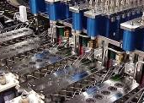
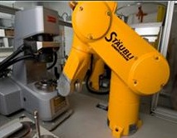
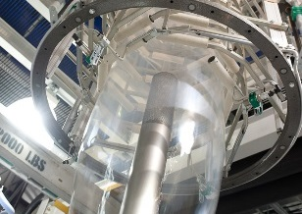
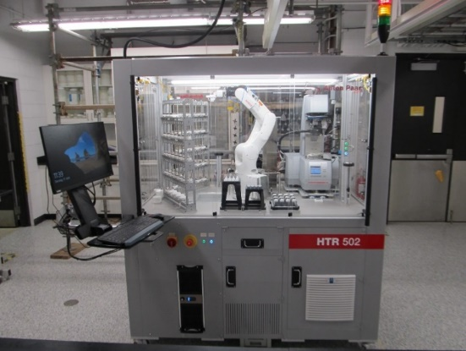
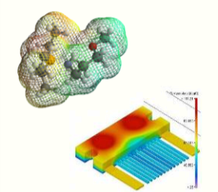
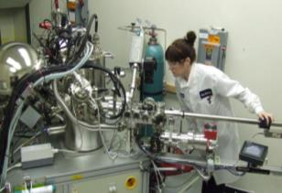
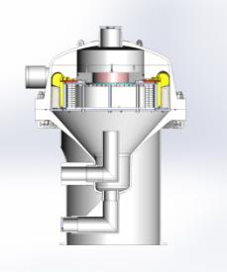
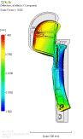
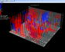

About Dow R&D
High quality capabilities
high throughput • analytical • application testing • modeling and computation • data science

Slide 5
Citizen Data Science at Dow
As researcher in materials science research and development, we have messy, unstructured, and scattered data.
Creating value from our data requires researchers to deeply embed in data analysis workflows to impart their experience.

Slide 6
Data Science as an Interdisciplinary Endeavor
Domain Expertise
Computer Science
Math & Statistics
Traditional Research
Data Stewardship
Data Science
Machine Learning
Adapted from Shelly, Data Science for the C-Suite. New York: Digital Living Press, 2015. Print.

Slide 7
Citizen Data Science for Research and Development
Wrangling
Collection
Analysis
Decision
The Citizen Data Scientist enriches a data-centric cultural foundation by adhering to…
a governance framework for data best practices, and practicing behaviors that are data-centered.
The Digital Infrastructure forms…
a technology base focused on the needs of the “data pyramid.”
Governance
Behaviors
Technology
Data Foundation

Slide 8
A Citizen Data Scientist’s Goal
Construct a tidy data project that supports collaborative, transparent, and reproducible workflows.

Slide 9
Guidelines for Success
Data Organization
Store & organize data at the level of a project
Store raw data in a managed system
Organize data to reflect observational hierarchy
Use tidy data tables
Document the structure of the data
Data Analysis
Separate data storage and analyses
Create transparent analysis routines
Divide analysis into minimal components
Implement version control for data, analysis, & platform
Data Access
Make data accessible to both humans and machines
Remove artificial barriers to data access
Provide easy means to add and edit data
Visualize your data as soon & as much as possible
Value Preservation
Package projects for long term storage
Transend platforms & languages with shareable interfaces

Slide 10
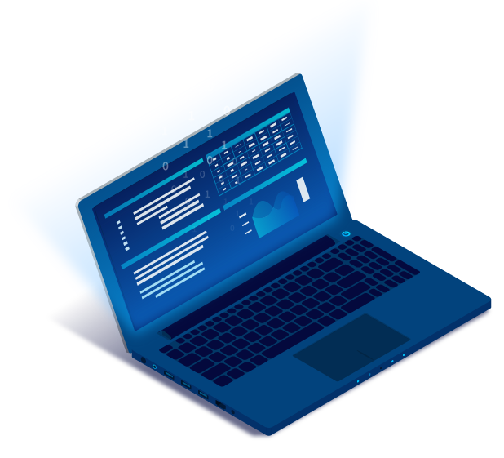
A Workbench for Citizen Data Science
As a Citizen Data Scientist in R&D, I need a data science workbench that offers
an approachable & collaborative workspace that welcomes new researchers
capabilities & convenience of a modern development environment with extremely low barriers to exploring ideas and starting projects
safe & secure data connectivity with minimal overhead
simple, secure, & rapid deployment requiring no new permissions or reviews
Our solution: RStudio Team
Image from RStudio - Used with permission

Slide 11

What to build? Tidy data project
Where to build it? RStudio Team
How to build it? _____________
how to code in R|

Slide 12
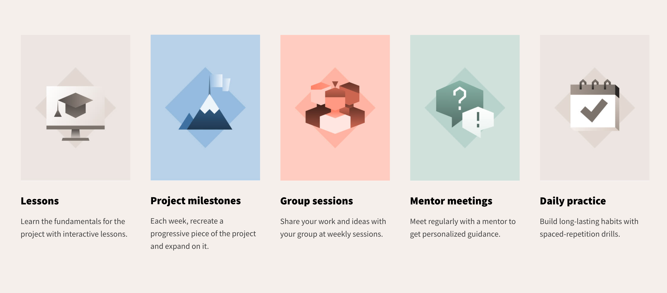
RStudio Academy
rstudio.com/academy
Images from RStudio | Used with permission

Slide 13


vs

Slide 14
What you need for Academy
🧑‍🎓 Academy Learners – 5 to 7 per cohort
🧑‍🏫 Cohort Mentors – from RStudio & Your Group
🛠 A Project – The closer to your work, the better

Slide 15
Who is a GOOD candidate?
Intrinsic motivation: you need to solve a data problem
You have a project to apply your knowledge
You have time and support to participate

Slide 16
Who is a BAD candidate?
You are an experienced R user
"I know R, but I want to learn the 'right' way to code"
You have built and deployed a custom shiny app
You participate in #tidytuesday on a regular basis
You are good at tidy evaluation?
You have written or contributed to an R package?
You want to learn a new skill
“It would be fun to learn how to code”
You don’t have any data to use

Slide 17
What makes a good cohort?
Similar work group
Similar time zone
Similar skill level

Slide 18
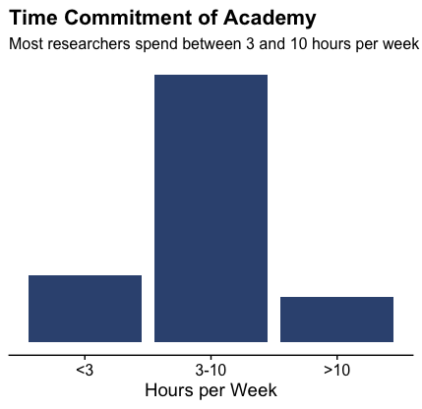
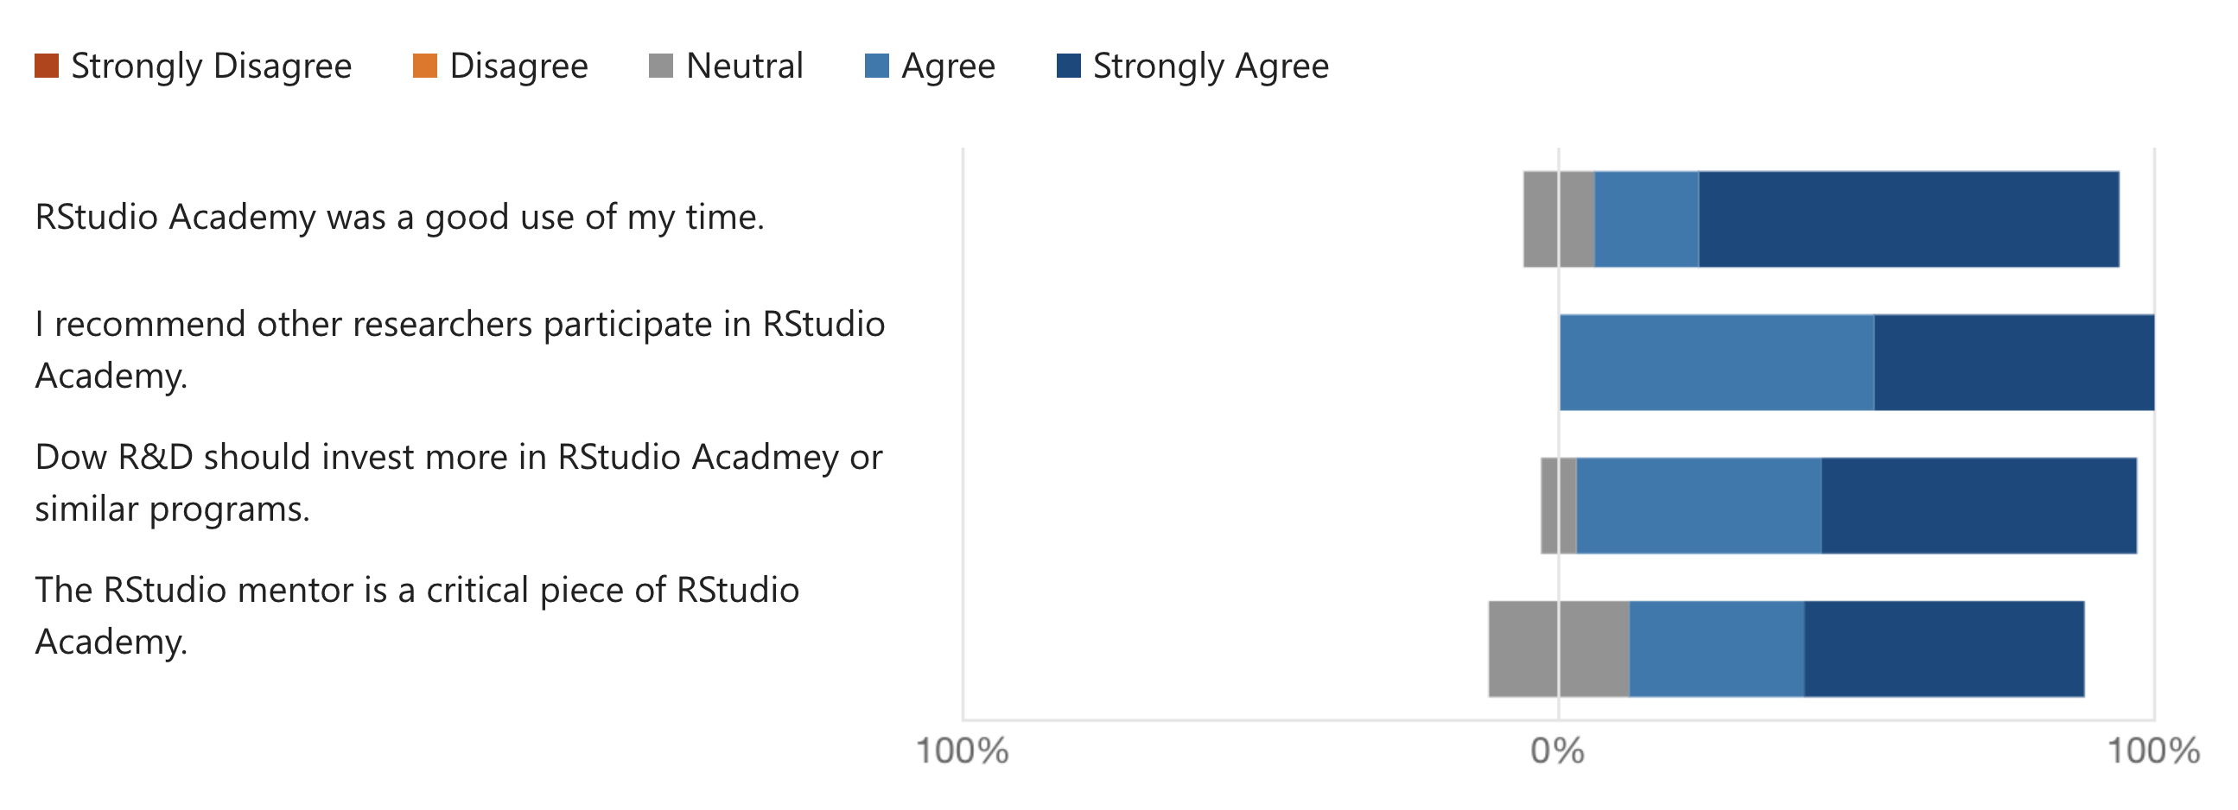
Feedback for RStudio Academy
“The group sessions were a critical part of the accountability for me to ensure that I stayed on track and had inspiration from others that I could try in my own code. The format of the academy learning pages led to an outstanding user experience, with the bite-size learning messages and integrated code chunks to write and run.”
“The RStudio Academy is an excellent way for researchers to get acquainted with the concept of using basic data science and programming to both analyze and communicate their data…. I would highly recommend to most researchers in Dow who are interested in any data science or data analytics roles.”

Slide 19
After Academy
More Advanced Lessons
Transfer to Workbench
Community Building
Academy only touches on reproducible reporting and deployment but sharing your analysis results with others is where much of the value in data analysis resides.

Slide 20
RStudio Academy Success Story
Simplifying a Walk-up Lab with Shiny

Slide 21
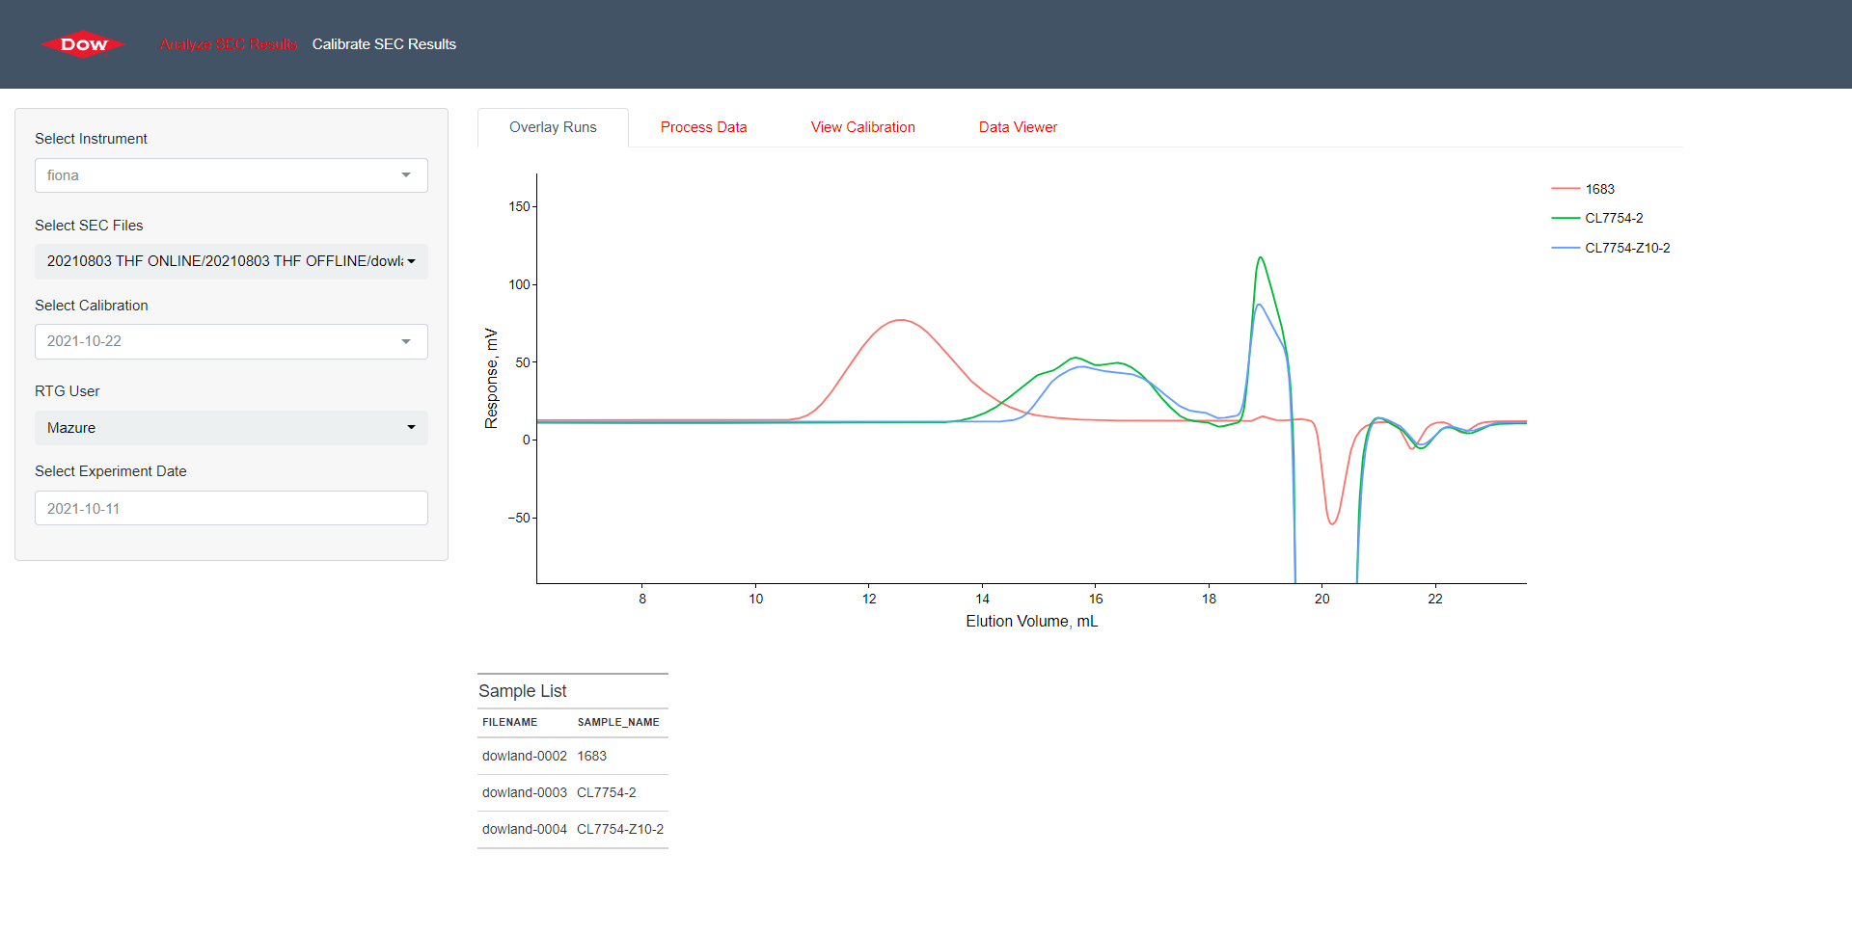
Data Analysis Tool for Polymer Analysis
Purpose
Empower walk-up users to analyze their own data without sacrificing integrity of data analysis
Benefit
Improved experience for walk-up users and researchers supporting walk up instrumentation
Polymer Characterization Data Analysis Tool
The graphic representations are presented here for illustrative purposes only and should not be construed as product specifications.

Slide 22
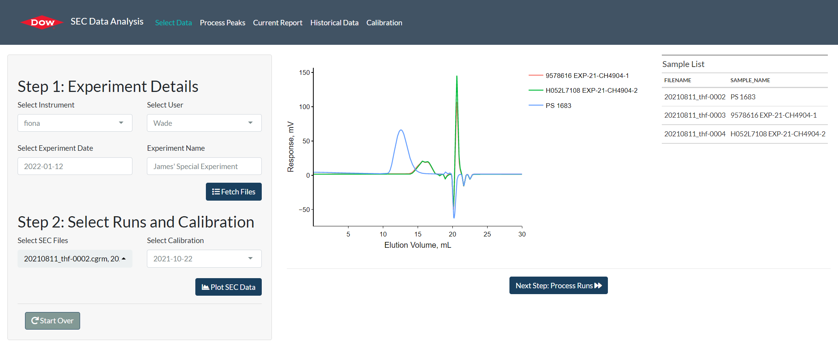
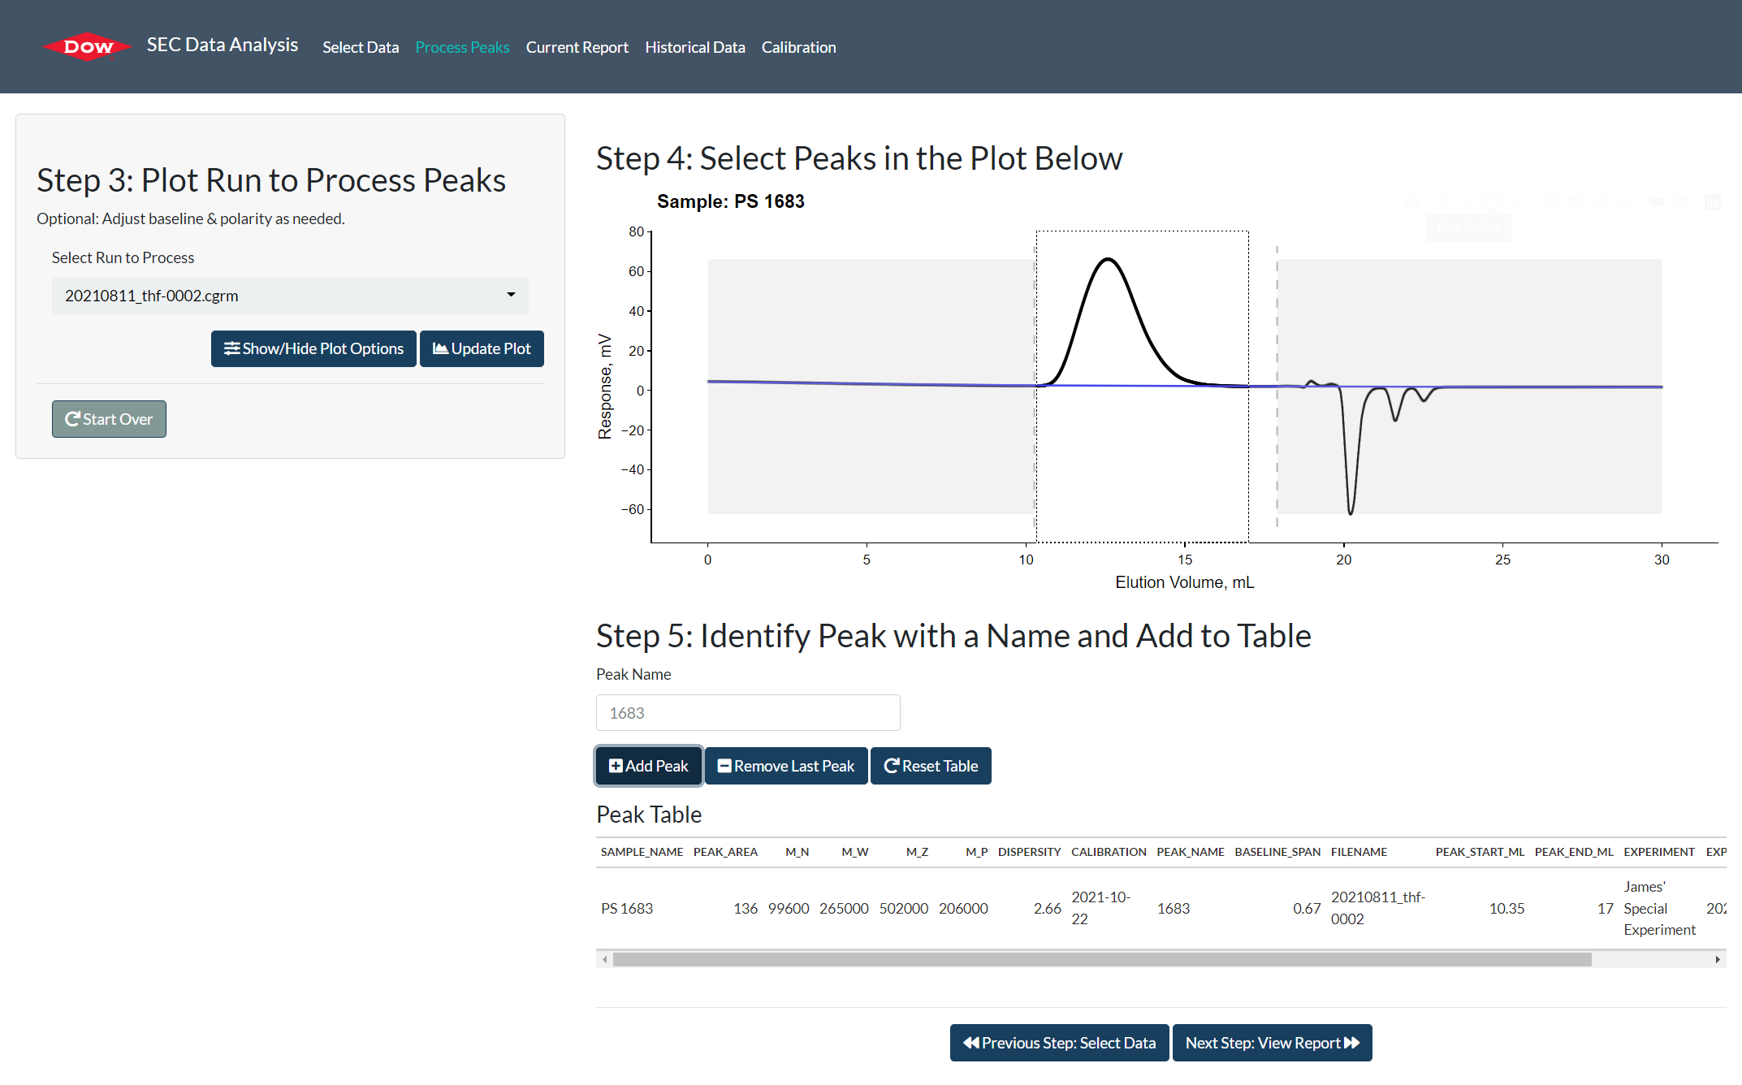
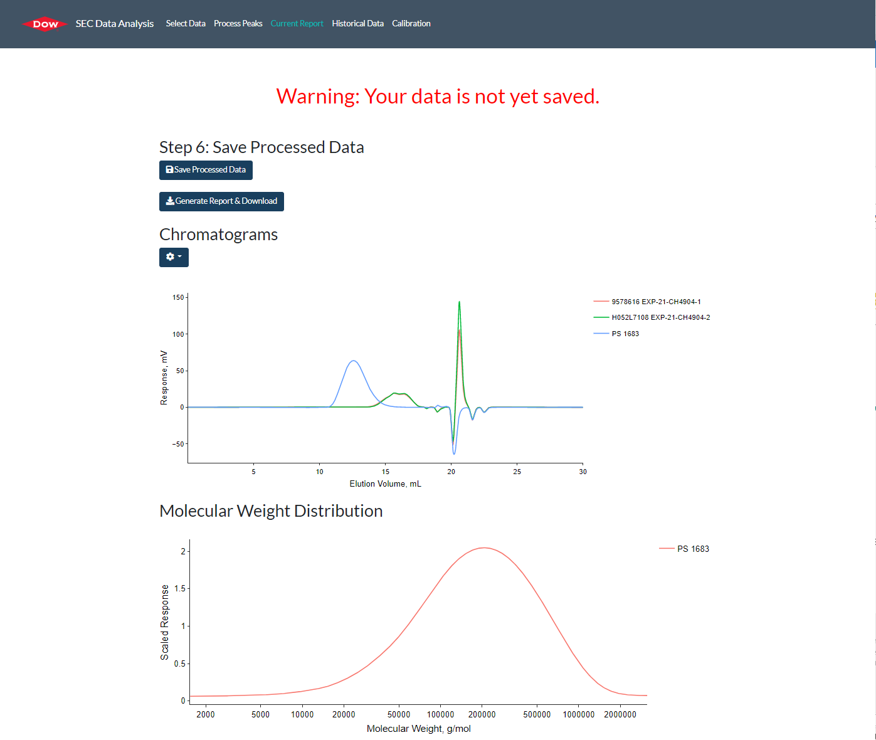
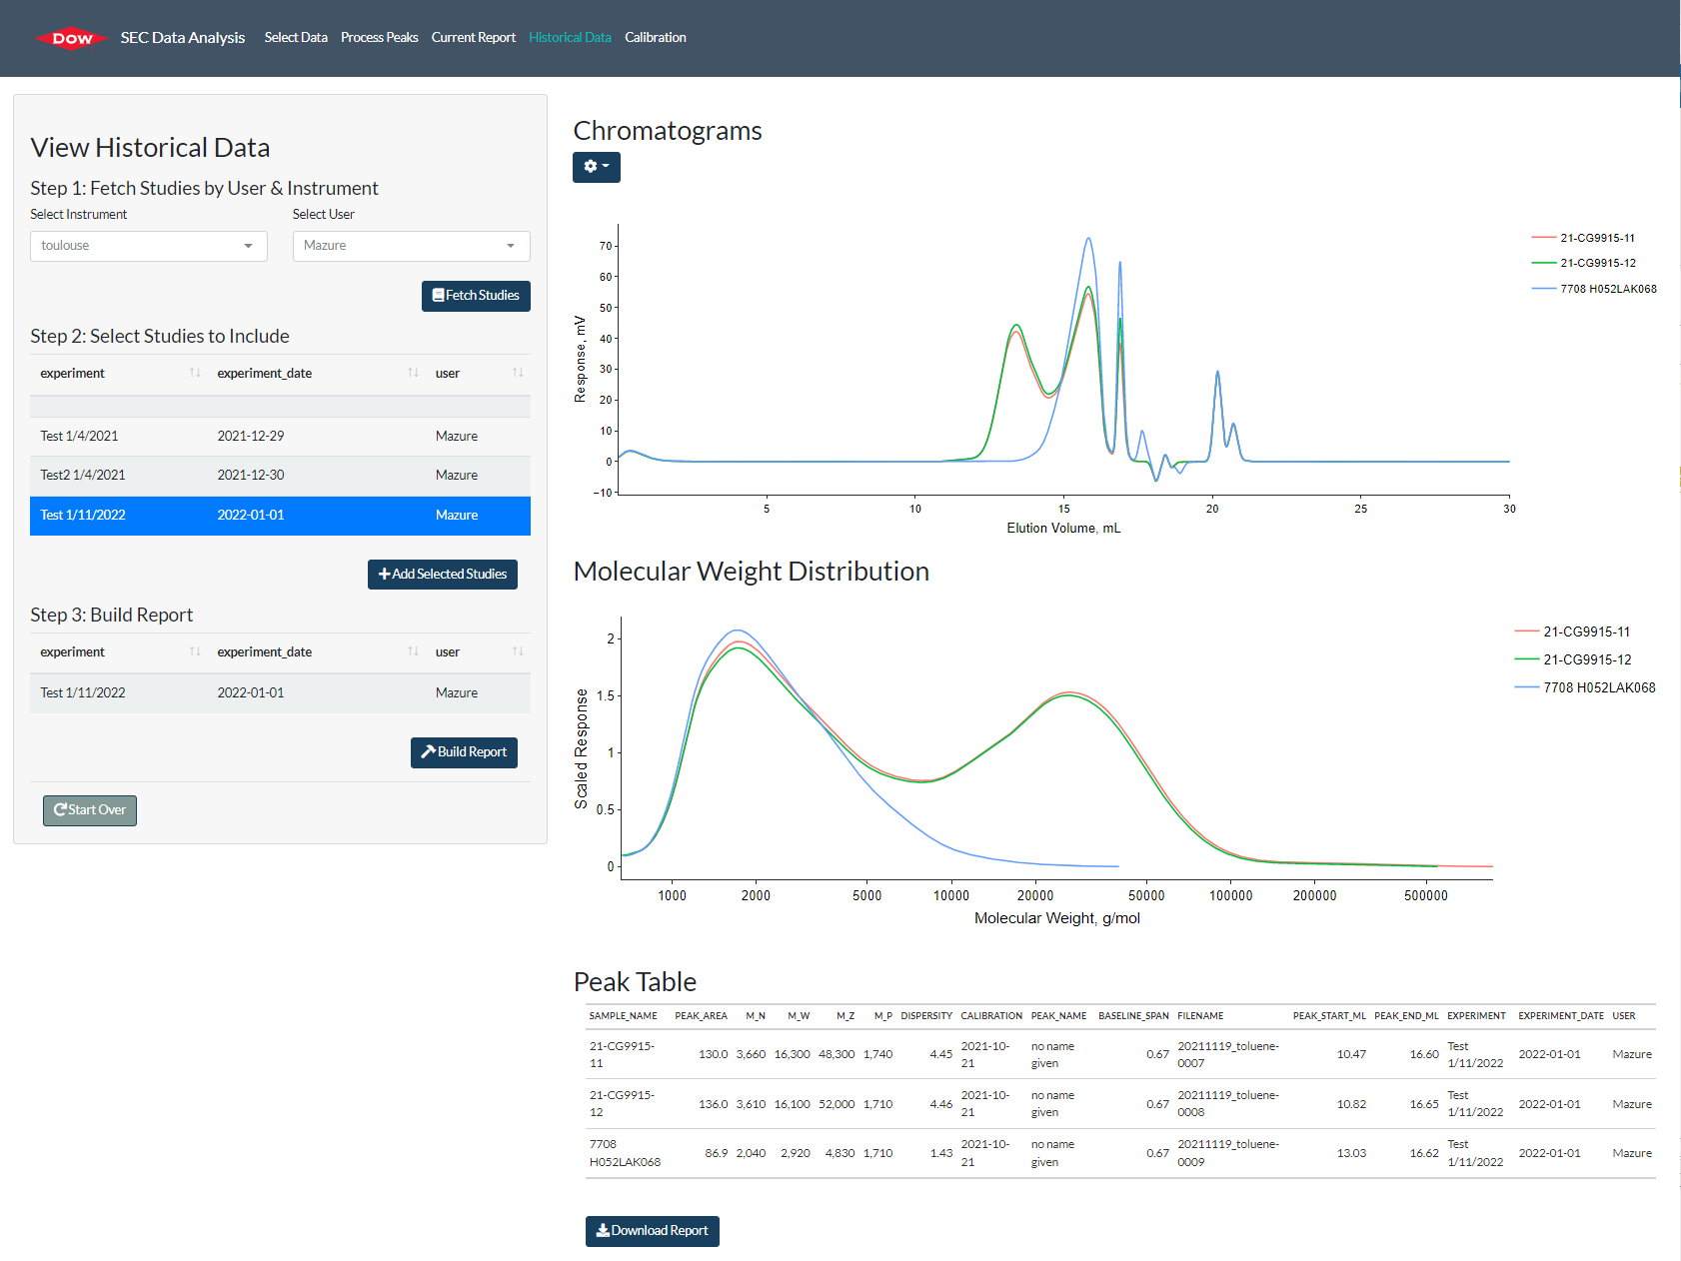
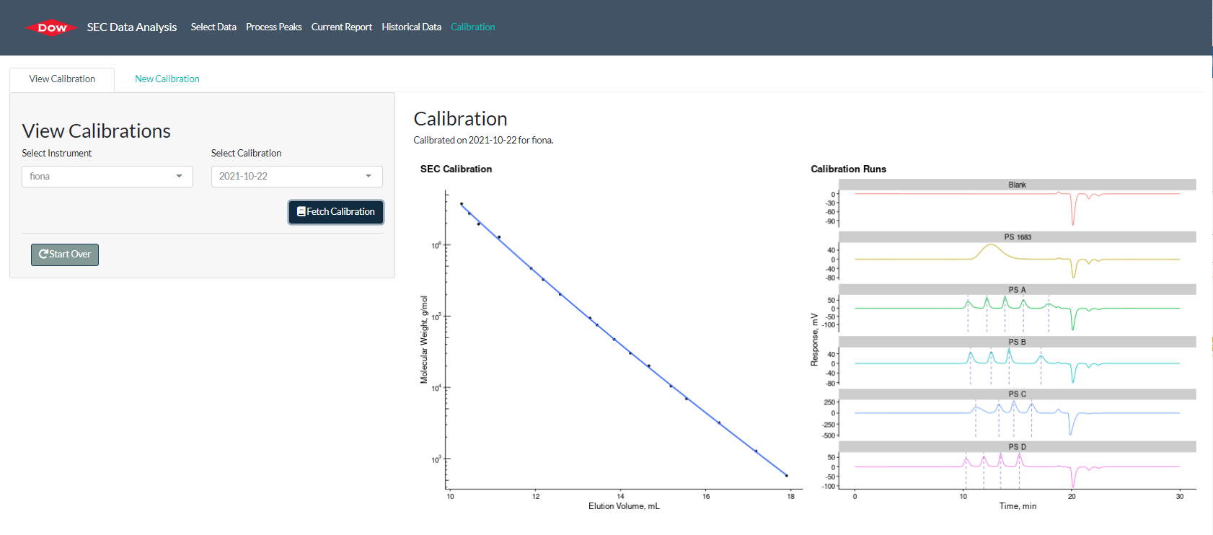
Data Analysis Tool for Polymer Analysis
1
Select & Plot Data
2
Analyze Data
3
Generate Report
4
View Historical Data
5
Inspect Calibrations
The graphic representations are presented here for illustrative purposes only and should not be construed as product specifications.

Slide 23
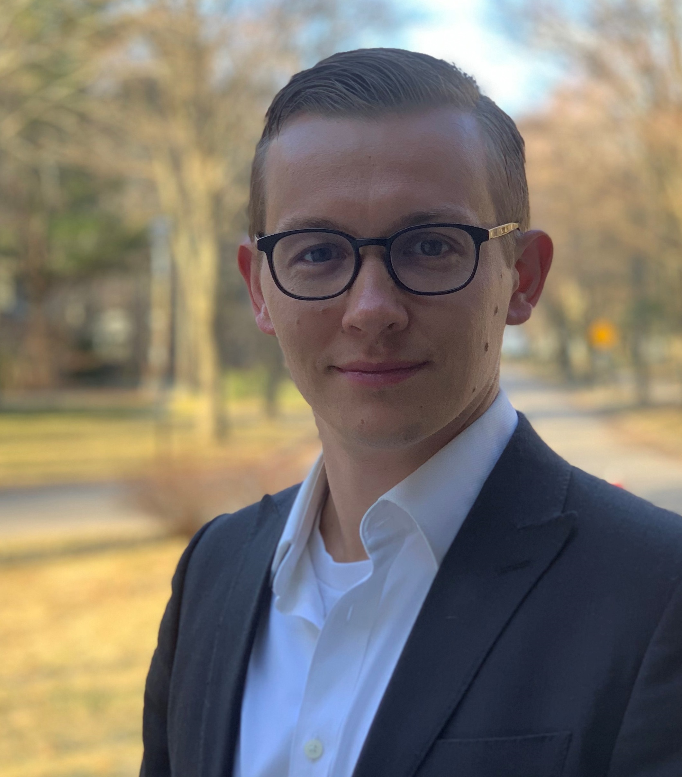
Acknowledgments
Thank you to our mentors & partners!
Dow
Michael Hausinger
Tim Licquia
Lynette Naler
Camila Saez
Academy Participants!
RStudio
Kristin Bott
Daniel Chen
Desiree De Leon
Hadrien Dykiel
Deirdre Francks
Brian Law
Katie Masielo
Eric Pite
Steven Smallberg
Tony Sokolov
linkedin.com/in/anatoliysokolov/

Slide 25
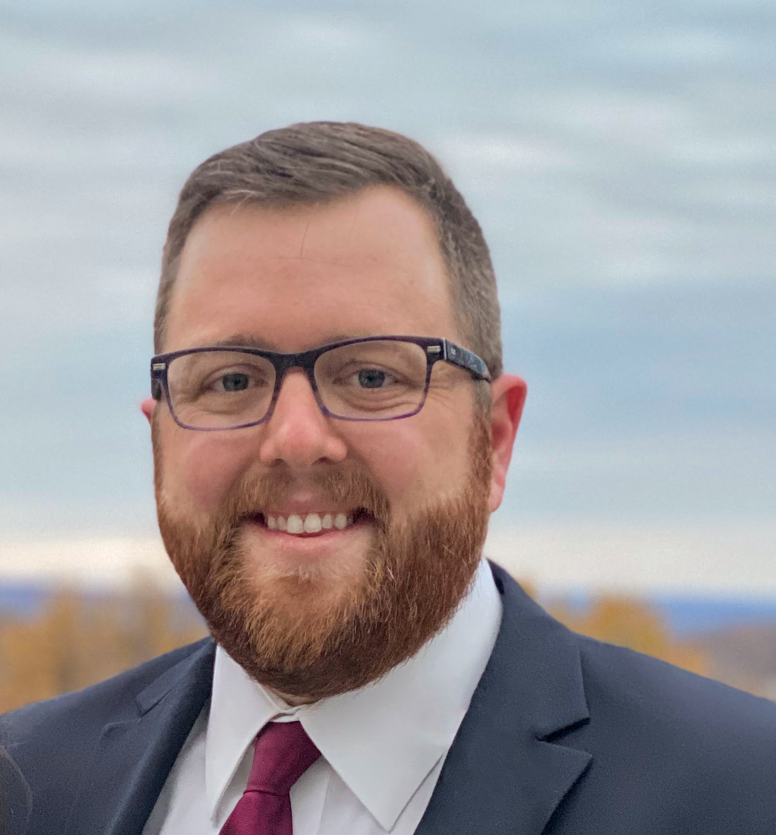
James Wade
 jhwade@dow.edu
 @jameshwade
 JamesHWade
 in/james-h-wade
 jameshwade.com
Disclaimer: this presentation is provided in good faith for informational purposes only. Dow assumes no obligation or liability

